Slide 1
Smart Medication Safety: Real-Time Drug Interaction Alerts via EHR Integration
Rongrong Wang, Jinying Xing, Shengji Jin, Shujun Jiang

Slide 2
Problem & Background
The Serious Risks of Polypharmacy
Nearly 45% of adults aged 65+ take ≥5 medications (Delara et al., 2022)
Drug–drug and drug–food interactions may lead to treatment failure, increased toxicity, or unexpected adverse events(Peng et al., 2021; Koziolek et al., 2019)
Polypharmacy is consistently associated with increased hospitalizations, preventable adverse drug events (ADEs), and greater healthcare burden (Davies et al., 2020)

Slide 3
Problem & Background
Clinical & Patient Challenges
Clinician Side
EHR alerts often static, generic
Risk of alert fatigue → critical warnings ignored
Lack of real-time, contextual analysis
Patient Side
Limited awareness of drug–food/supplement interactions
No proactive guidance outside clinical visits
High-risk actions may go unnoticed

Slide 4
Problem & Background
Gaps in Current Systems
Current tools lack
Real-time medication monitoring
Personalized risk evaluation
Patient engagement beyond clinics
Consequences
Preventable ADEs
Missed education opportunities
Reduced medication safety

Slide 5
Proposed Solution–The need for an Intelligent Platform
What we need:
1. Seamless EHR integration to extract & analyze med data
2. Context-aware interaction alerts for both clinicians & patients
3. Personalized notifications (e.g., mobile alerts, educational prompts)

Slide 6
Clinical Impact & Users
Who Benefits from the AI-based Medication Safety Platform?
Patients – Empowered and Protected
1. Stay on schedule and take medications correctly
2. Avoid risky combinations with real-time alerts
3. Understand medications through simple education
Clinicians – Smarter, Safer Decisions
1. Real-time interaction checks during prescribing
2. Suggest safer alternatives based on patient profile
3. Support patient communication with clear content

Slide 7
Clinical Impact & Users
Who Benefits from the AI-based Medication Safety Platform?
Healthcare Institutions – Safer Systems, Better Outcomes
1. Reduce avoidable ADEs and readmissions
2. Enhance digital integration with EHR and apps
3. Meet safety standards and save clinical time

Slide 8
Key Features - AI-Based Medication Interaction Monitoring Platform
EHR Integration via FHIR Standards
- Seamless integration with major EHR systems
- Real-time clinical decision support for interaction screening
- Context-aware alerts based on patient-specific factors (Slight et al., 2019)
Comprehensive Patient Mobile Application
- Medication scanning for interaction identification
- Customizable food database with dietary warnings
- Voice-enabled reminders for improved accessibility
- Multilingual support
Notes:
Our AI-based medication interaction monitoring platform brings 4 important features.
First, our EHR Integration via FHIR Standards enables seamless connection with major electronic health record systems. This provides real-time clinical decision support that automatically screens for potential drug interactions during prescribing. Unlike traditional systems, our context-aware alerts consider patient-specific factors such as age, comorbidities, and organ function—significantly reducing alert fatigue while maximizing clinical relevance.
Second, our Comprehensive Patient Mobile Application serves as a personal medication safety companion. Patients can scan medications to identify potential interactions with their current therapies, access a customizable food database screening tool for dietary considerations, and receive voice-enabled reminders—making it accessible for older adults and visually impaired users. And the application supports multiple languages.

Slide 9
Key Features - AI-Based Medication Interaction Monitoring Platform
3. Knowledge Graph and Intelligence Engine
- Comprehensive medication-food interaction database
- Patient-friendly language via NLP capabilities
- Severity-based risk stratification algorithm
- Machine learning for continuous accuracy improvement (Chen et al., 2022)
4. Expandable Architecture for Future Integration
- API framework for genomic data integration
- Wearable device interoperability
- Secure authorized data sharing capabilities
Notes:
At the heart of our platform is a sophisticated Knowledge Graph and Intelligence Engine that I will introduce in the next session. Our natural language processing translates complex medical warnings into patient-friendly language, while our risk stratification algorithm categorizes interactions by severity and provides appropriate recommendations. The system's machine learning components continuously improve detection accuracy based on clinical feedback and emerging evidence.
Looking ahead, our Expandable Architecture supports future integration with genomic information for personalized therapy, wearable health devices for real-time physiological data, and secure sharing capabilities with healthcare providers and caregivers when authorized by patients. This forward-looking design ensures our system will evolve alongside advances in personalized medicine and digital health technology, making it a sustainable investment for healthcare organizations.

Slide 10
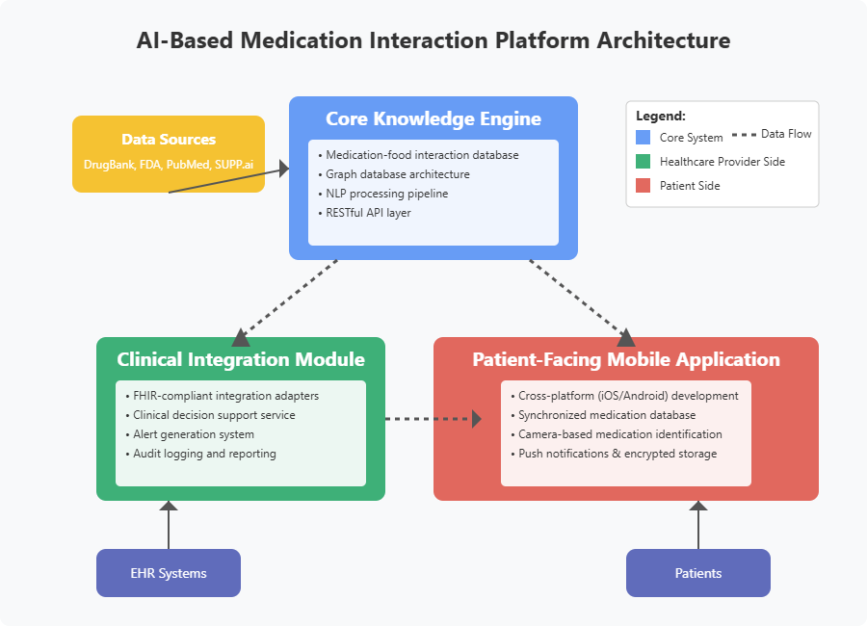
Technical Plan - Work as an integrated ecosystem
Notes:
Our AI-Based Medication Interaction Platform features a three-component ecosystem designed for seamless integration and maximum impact. At its core, our Knowledge Engine utilizes a graph database architecture compiled from validated sources like DrugBank and FDA, with NLP capabilities to translate complex medical information appropriately for different users. The Clinical Integration Module connects with major EHR systems through FHIR-compliant adapters, providing configurable alerts that reduce tiredness while maintaining safety. Finally, our Patient-Facing Mobile Application offers cross-platform accessibility, camera-based medication identification, and secure synchronization with clinical records—creating a comprehensive system that protects patients throughout their medication journey.

Slide 11
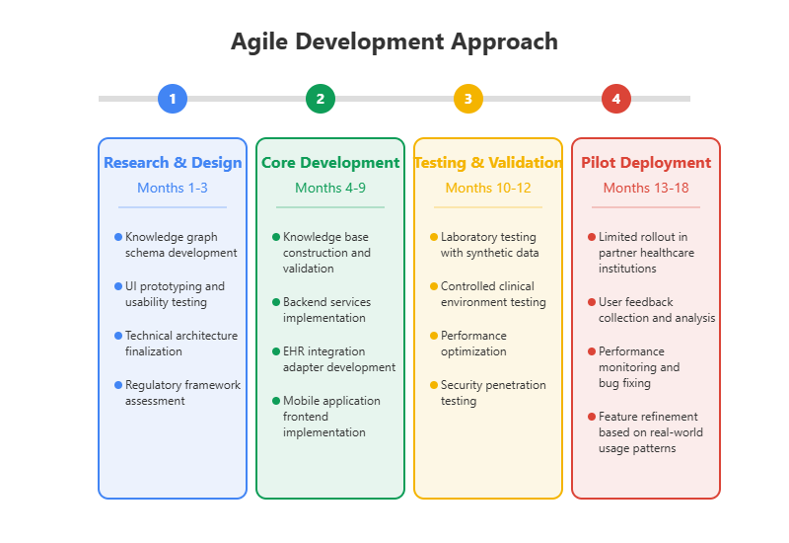
Technical Plan - Development Methodology & Resources
Notes:
Our planned 18-month agile development roadmap breaks down into four strategic phases. We begin with three months of foundational research and design, establishing our knowledge graph schema and technical architecture. Months 4-9 focus on core development including knowledge base construction and EHR integration. Testing and validation occupy months 10-12, with synthetic data and security testing. Finally, our six-month pilot deployment phase allows for real-world feedback collection and feature refinement before full-scale implementation.

Slide 12
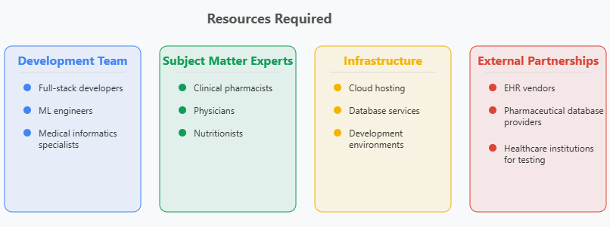
Technical Plan - Development Methodology & Resources
Notes:
Successful implementation depends on our multidisciplinary team including full-stack developers, ML engineers, and medical informatics specialists, supported by clinical experts like pharmacists and nutritionists. We'll leverage cloud infrastructure and strategic partnerships with EHR vendors, pharmaceutical database providers, and healthcare institutions to ensure seamless deployment and comprehensive validation of our platform.

Slide 13
Social Business Model
Value Proposition:
Social Value :
Reduce the incidence of adverse drug events
Improve medication compliance and patient education
Support precision medicine and digital health transformation
Customer Value :
Hospitals: reduce readmissions, optimize drug management, and improve patient satisfaction
Doctors: save time looking for interactive information and get smart recommendations
Patients: get clear and easy-to-understand medication instructions and real-time reminders
Segments：
Beneficiaries:
old people with multiple medications, chronic diseases (such as diabetes, hypertension) ,health care workers (reduce risks by improving decision-making efficiency)
Customers:
medical institutions (hospitals, clinics), health insurance companies (manage medication risks for customers), government and public health organizations (improve medication safety)

Slide 14
Social Business Model
Type of Intervention:
Smart platform + EHR system integration + mobile app for patients
Doctor :
Real-time reminder of drug interactions and substitution suggestions when prescribing drugs.
Patient :
App pushes personalized warnings, dietary recommendations, and medication education content.
Channels:
Medical system: through EHR system interface (Epic, Cerner, etc.)
Patient side: App download promotion, doctor recommendation
Medical insurance partners: through API integration or data sharing interface
Clinical pilot hospital: as a test and expansion entry

Slide 15
Social Business Model
Partners & Stakeholders:
Medical information system providers (such as Epic, Cerner)
Hospitals, community health service centers
Drug database licensees (DrugBank, SUPP.ai)
Health insurance companies or pharmaceutical management organizations (PBMs)
Patient associations, elderly organizations
Key Activities:
Knowledge graph and database development (integration of FDA, DrugBank, etc. data)
AI model and natural language processing development
EHR system integration and API development
Mobile App design and multilingual localization
Partner hospital clinical pilot and user feedback collection
Key Resources:
AI development and medical knowledge graph team
Clinical cooperation agency (for verification and feedback)
Drug database authorization (FDA, DrugBank)
Software development platform and cloud infrastructure

Slide 16
Social Business Model
Revenue:
Software licensing fees or subscription fees from healthcare institutions (SaaS)
Risk control solution fees paid by health insurers
Government-supported public health project funding
Professional version app subscription (for patient families/premium features)
Cost Structure
Personnel expenses (AI engineers, medical consultants, developers)
Data licensing fees (drug database)
System maintenance and cloud service fees
Regulatory compliance support (HIPAA/FDA review)
Surplus :
Reinvest in AI model optimization and multilingual localization
Expand indications (such as psychotropic drug management)
Integrate with wearable devices to improve medication data accuracy

Slide 17
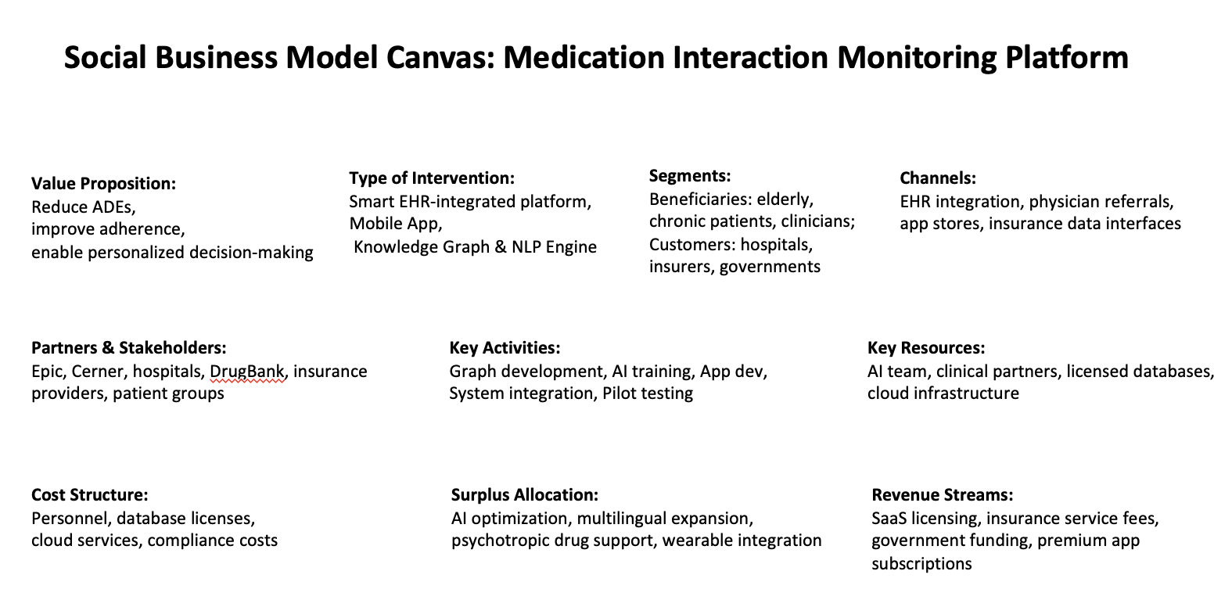

Slide 18
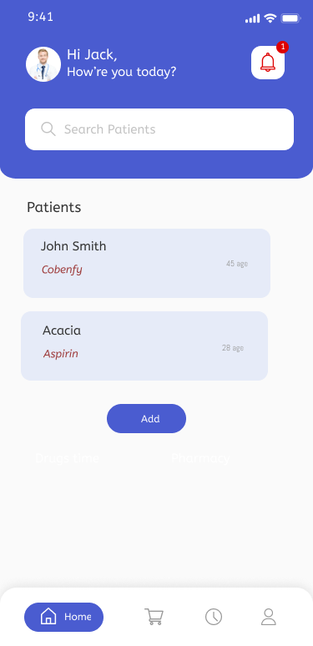
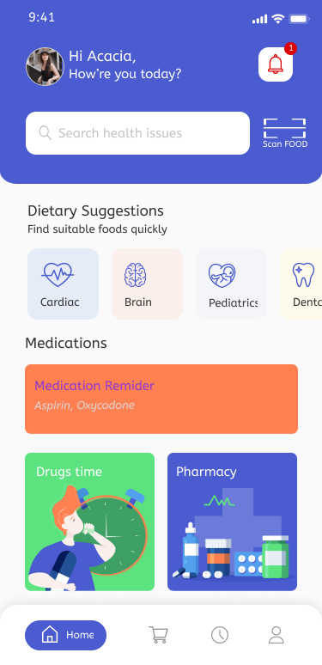
Implementation (Feasibility Statement)
Clinicians’ UI
Patients’ UI

Slide 19
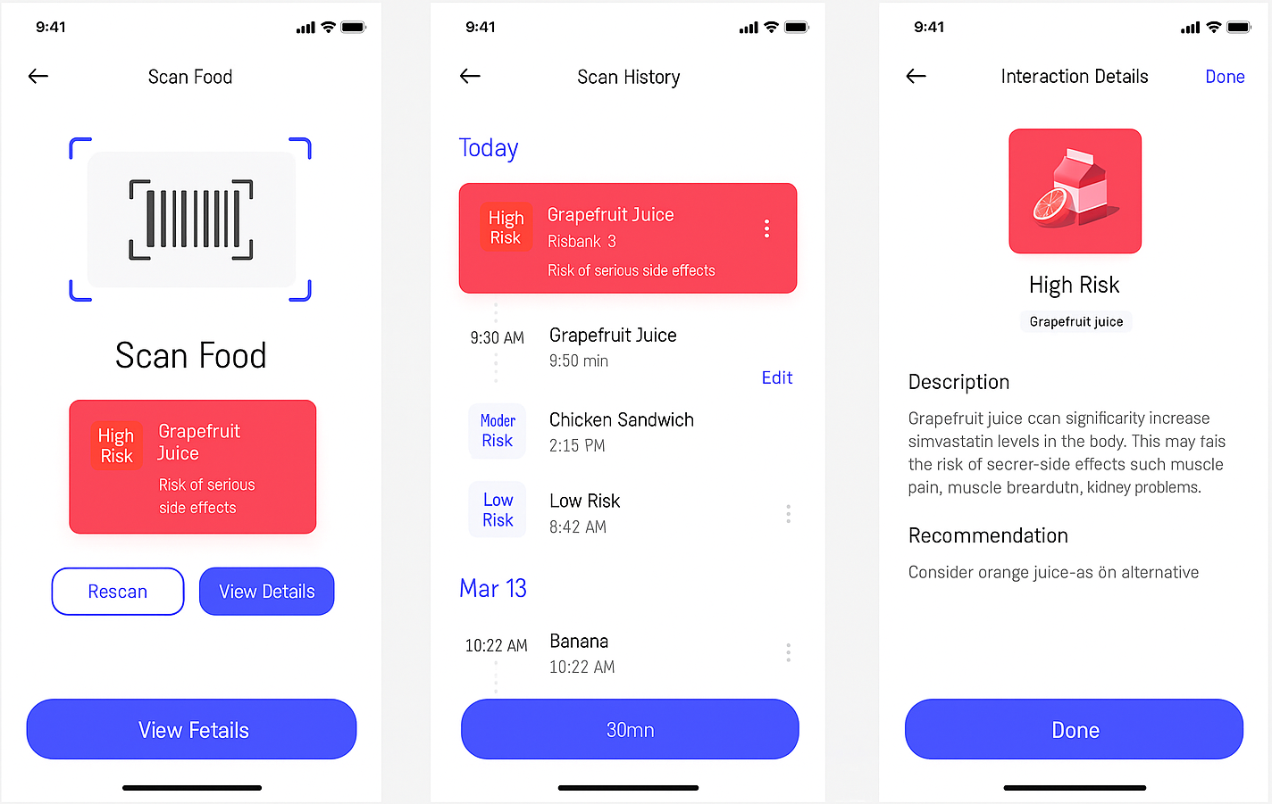
Implementation (Feasibility Statement)
Purpose of the Scanning Feature:
Allows the patient to scan food or drug items to learn their basic information.
Helps the patient interact with common food and drug products, especially those currently being used.
Risk Detection and Alerts:
If a scanned drug has dangerous interactions with the patient's current medications, the user should receive a warning.
If a scanned food or drug is blacklisted by the doctor, the system should advise the user to use with caution.

Slide 20
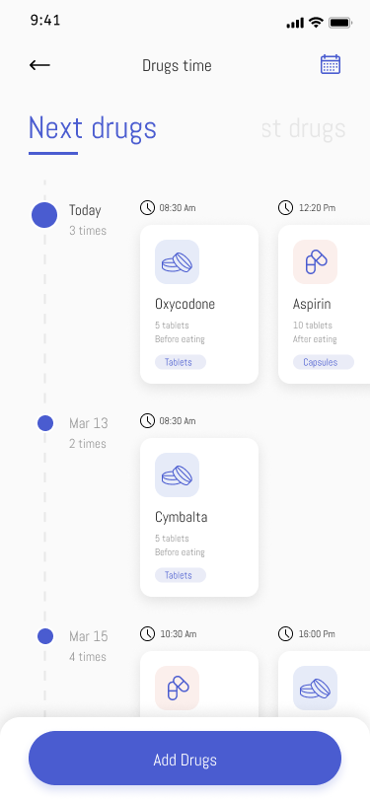
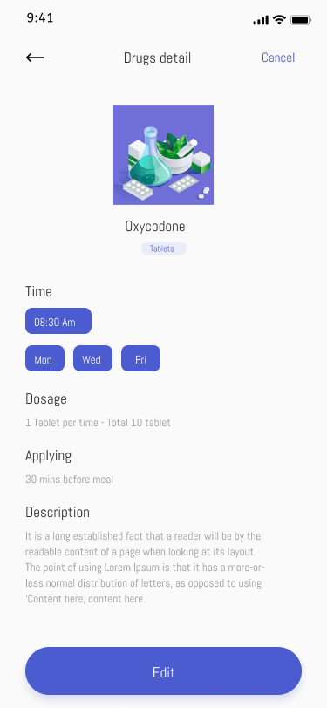
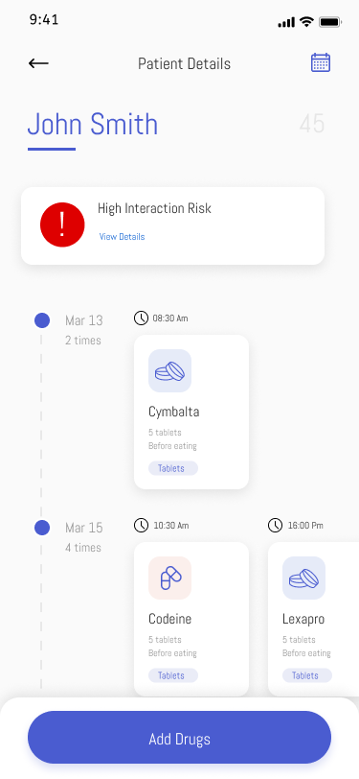
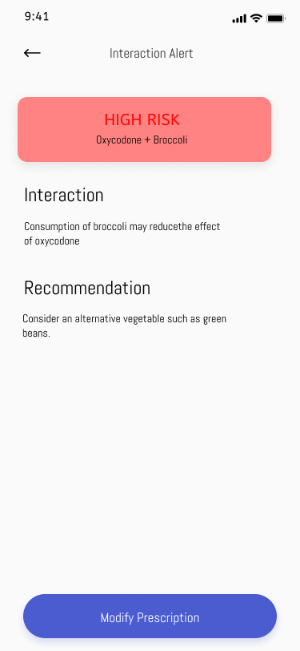
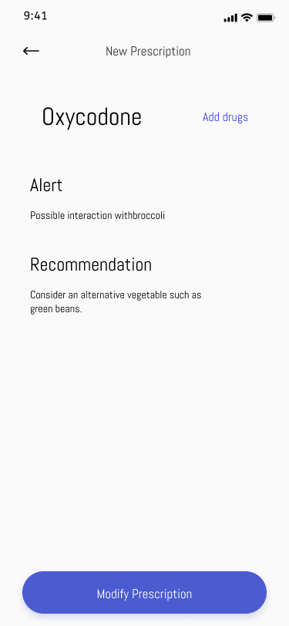
Implementation (Feasibility Statement)
Doctor Notification and Intervention:
The system should automatically notify the doctor if a potential risk is detected.
The doctor can then decide if intervention is required.

Slide 21
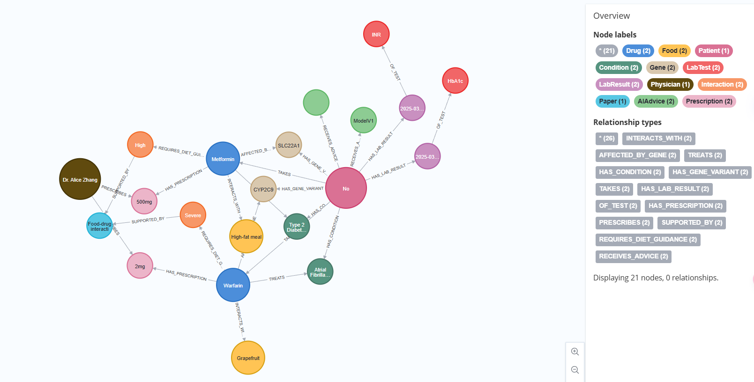
Implementation (Feasibility Statement)

Slide 22
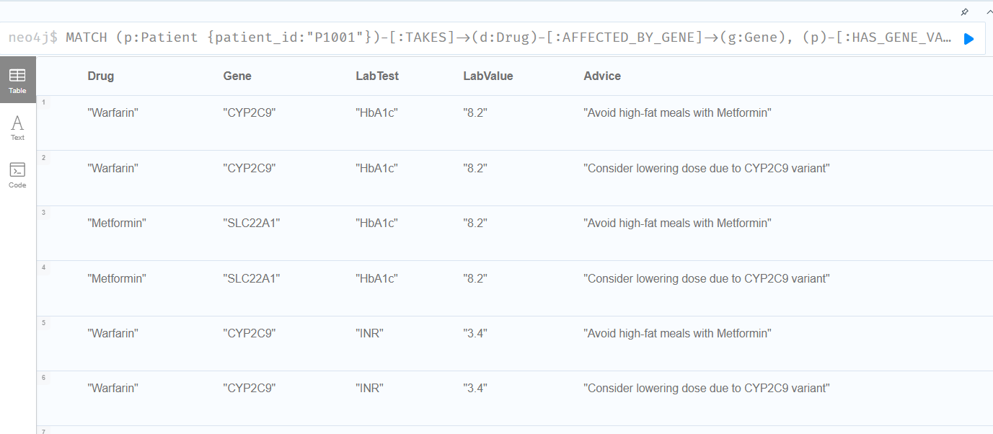
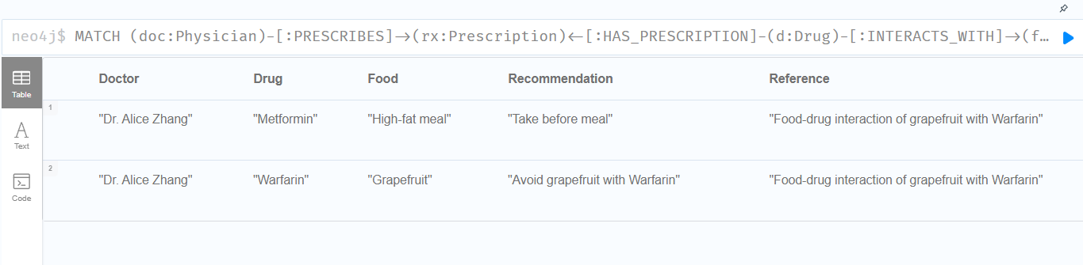
Implementation (Feasibility Statement)
MATCH (p:Patient {patient_id:"P1001"})-[:TAKES]->(d:Drug)-[:AFFECTED_BY_GENE]->(g:Gene),
(p)-[:HAS_GENE_VARIANT]->(g),
(p)-[:HAS_LAB_RESULT]->(lr)-[:OF_TEST]->(t: LabTest),
(p)-[:RECEIVES_ADVICE]->(advice: AIAdvice)
RETURN d.name AS Drug, g.name AS Gene, t.name AS LabTest, lr.value AS LabValue, advice.text AS Advice
MATCH (doc:Physician)-[:PRESCRIBES]->(rx:Prescription)<-[:HAS_PRESCRIPTION]-(d:Drug)-[:INTERACTS_WITH]->(f:Food),
(d)-[:REQUIRES_DIET_GUIDANCE]->(i:Interaction)-[:SUPPORTED_BY]->(paper:Paper)
RETURN doc.name AS Doctor, d.name AS Drug, f.name AS Food, i.advice AS Recommendation, paper.title AS Reference

Slide 23
Conclusion
Our AI-powered medication safety platform addresses the real risks of polypharmacy with real-time, personalized alerts.
Empowering both clinicians and patients, we bridge the gap between hospital systems and everyday medication use.
With scalable architecture and EHR integration, this solution is practical, impactful, and have ability to land in reality.

Slide 24
Reference:
Chen, Y., Zhang, L., & Huang, J. (2022). Machine learning approaches for drug-drug interaction prediction: A review of current status and future prospects. Briefings in Bioinformatics, 23(1), bbab301. https://doi.org/10.1093/bib/bbab301
Slight, S. P., Beeler, P. E., Seger, D. L., Amato, M. G., Her, Q. L., Swerdloff, M., Dalleur, O., Nanji, K. C., Cho, I., Maniam, N., Eguale, T., Fiskio, J. M., Dykes, P. C., & Bates, D. W. (2019). A cross-sectional observational study of high override rates of drug allergy alerts in inpatient and outpatient settings, and opportunities for improvement. BMJ Quality & Safety, 28(3), 217-225. https://doi.org/10.1136/bmjqs-2018-008306
Davies, L. E., Spiers, G., Kingston, A., Todd, A., Hanratty, B., & Robinson, L. (2020). Adverse outcomes of polypharmacy in older people: systematic review of reviews. Journal of the American Medical Directors Association, 21(2), 181–187.e6. https://pubmed.ncbi.nlm.nih.gov/31926797/
Delara, M., Murray, L., Jafari, M., & Woodman, R. J. (2022). Prevalence and factors associated with polypharmacy: a systematic review and meta-analysis. BMC Geriatrics, https://pubmed.ncbi.nlm.nih.gov/35854209/
Moriarty, F., Hardy, C., Bennett, K., Smith, S. M., & Fahey, T. (2015). Trends and interaction of polypharmacy and potentially inappropriate prescribing in primary care over 15 years in Ireland: A repeated cross-sectional study. BMJ Open, 5(9), e008656. https://bmjopen.bmj.com/content/5/9/e008656
Peng, L., He, Z., & Chen, W. (2021). Mechanisms and risk factors of drug–drug interactions: A pharmacokinetic perspective. Pharmacological Research, 170, 105694. https://pmc.ncbi.nlm.nih.gov/articles/PMC7912632/
Koziolek, M., Grimm, M., Becker, D., Iordanov, V., Zou, H., Shimizu, J., & Weitschies, W. (2019). Investigation of pH and motility in the gastrointestinal tract of fasted human subjects using telemetric capsules. European Journal of Pharmaceutical Sciences, 134, 31–59. https://pubmed.ncbi.nlm.nih.gov/25411065/
Schmidt, L. E., & Dalhoff, K. (2002). Food-drug interactions. Drugs, 62, 1481-1502.
Bushra, R., Aslam, N., & Khan, A. Y. (2011). Food-drug interactions. Oman medical journal, 26(2), 77.
Wang, L. L., Tafjord, O., Cohan, A., Jain, S., Skjonsberg, S., Schoenick, C., ... & Ammar, W. (2019). SUPP. AI: finding evidence for supplement-drug interactions. arXiv preprint arXiv:1909.08135.
Schäfer, J., Tang, M., Luu, D., Bergmann, A. K., & Wiese, L. (2022). Graph4Med: a web application and a graph database for visualizing and analyzing medical databases. BMC bioinformatics, 23(1), 537.

Slide 25
Thank you

